Slide 1

Energy Hackathon
2024:
Food spoilage Detector
Presented by: Team 01 - ChemE+Friend
Phoebe, Shadab, Yosola, and Janelle

Slide 2

INCENTIVES
Minimize the global waste of food and environmental degradation
Monetization
Notes:
Minimize the global waste of food and environmental degradation as more people are likely to not toss it if they knew it would not go bad. (Some people have a harder time figuring out if something should be tossed or not).
It could be monetized. Bringing in producers income for whoever uses their devices as they could get it as a default app for their smart fridge and add it as a mandatory cost to the total cost of the fridge.

Slide 3
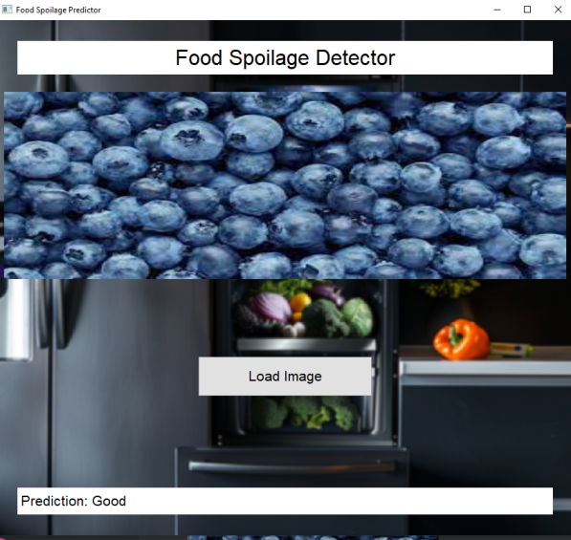
What is this?
Detects when your food in the fridge has gone bad.
So far only for fruits (blueberries).
Other food can be detected in the future after further ML model training.
Identify “fresh”, “going bad”, and “rotten” fruits.

Slide 4
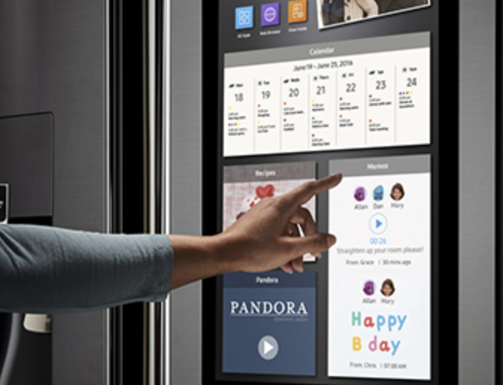
How to get the App?
Users can download app from app store (i.e. Samsung fridges download from Family Hub).
If downloading apps is not available, option to download app on mobile devices are available.

Slide 5
How does it work?
Consumers take photo of the contents in the fridge with fridge’s camera.
App will process the photo and run the code to detect signs of molding..
Message will appear to consumer of affected items that are molding.
Consumers download app to their fridge.
1
2
3
4

Slide 6

Demo Time!

Slide 7
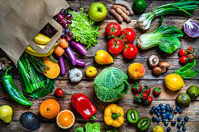
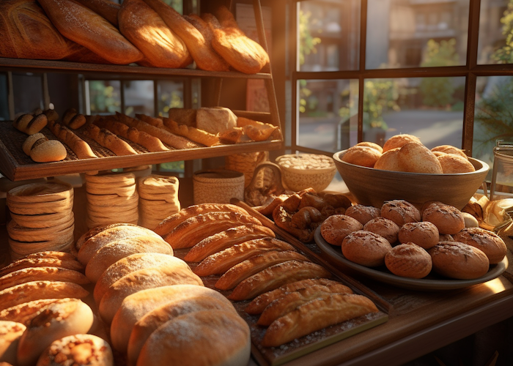

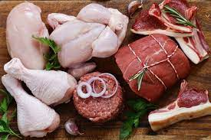
Next Steps!
Extend model prediction capability

Slide 8
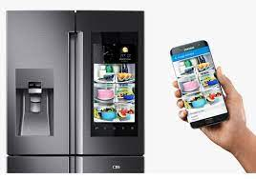
Next Steps!
Integrating model with the smart fridge camera to take photos in app.

Slide 9

Next Steps!
Development of the app further which would display predictions, recommendations, and other relevant information.

Slide 10
THANK YOU

